Slide 1
My first presentation

Slide 2
NATIONAL COLLEGE
BANASTHALI
NEPAL

Slide 3
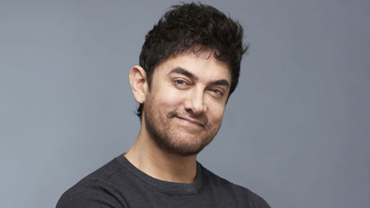
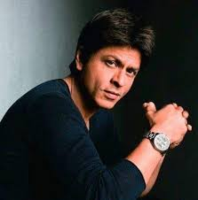
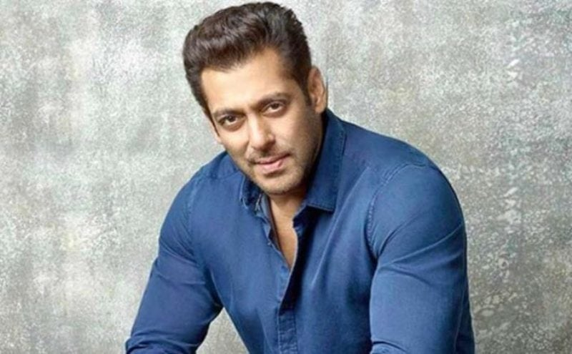
Three Khan's
Aamir Khan
Sharukh Khan
Salman Khan

